Slide 1
Enhancing participation in the sustainable development in the Bac
Hung Hai irrigation system (Vietnam)
Léo Biré, Quynh Nga Phung, Diep Anh Phung,
Baptiste Lesquoy, Patrick Taillandier

Slide 2
Unfolding of the presentation
I) Introduction
II) Scientific situation of the ACROSS project in public participation
III) The structuration of a research question
IV) Presentation of the field studied
V) Presentation of the participatory simulation using GAMA
VI) A few enhancements in GAMA software

Slide 3
I) Introduction
ACROSS (Advanced Computational Research for Sustainability Science) : created to address socio-environmental issues in socio-technical systems (irrigation systems) throughout Vietnam using modelling to foster new ways of management
Global context of increasing stresses on water resources, being either climatic, political or considering practices

Slide 4
II) Scientific situation of the ACROSS project in public participation
Participation Irrigation Management (PIM) (Peters, 2004)
A socio-political context marked by a “negotiated authoritarianism” (Gibert & Segard, 2015)
An approach interested in power relations relying on the hydro-social system theory (Swyngedouw, 2009)

Slide 5
III) The structuration of a research question
Interview campaign (43 interviews in two communes) with various stakeholders
Research question : how can we use participatory simulations to foster social dialogue about the pollution management system in the studied communes ?
Objectives : raise awareness, gather qualitative data on practices, foster social dialogue and empower the dominated populations in this context

Slide 6
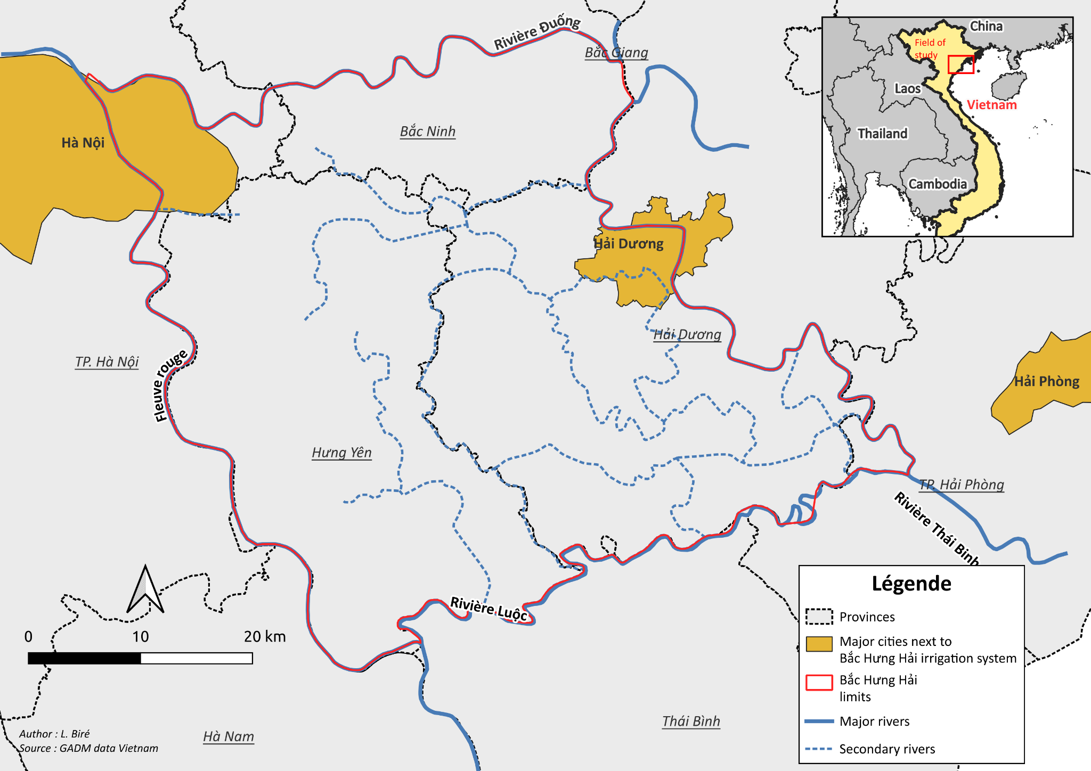
IV) Presentation of the field studied
Bắc Hưng Hải general location

Slide 7
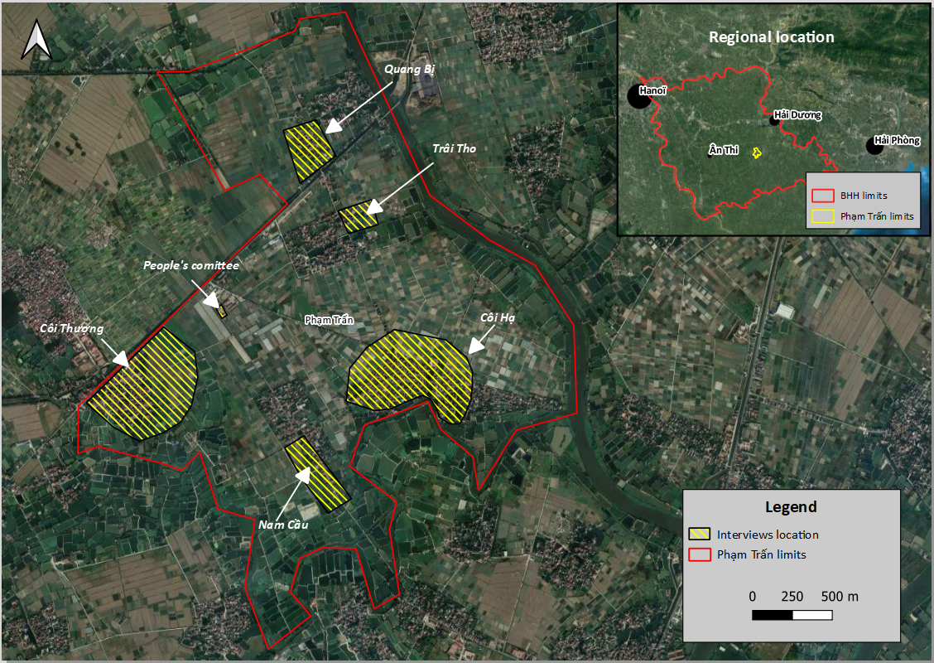
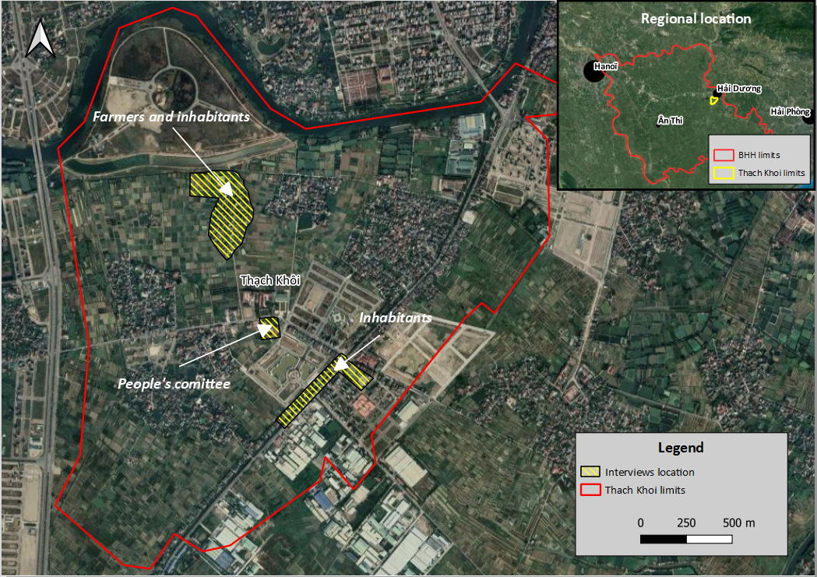
IV) Presentation of the field studied
Interviews location in Phạm Trấn
Interviews location in Thạch Khôi

Slide 8
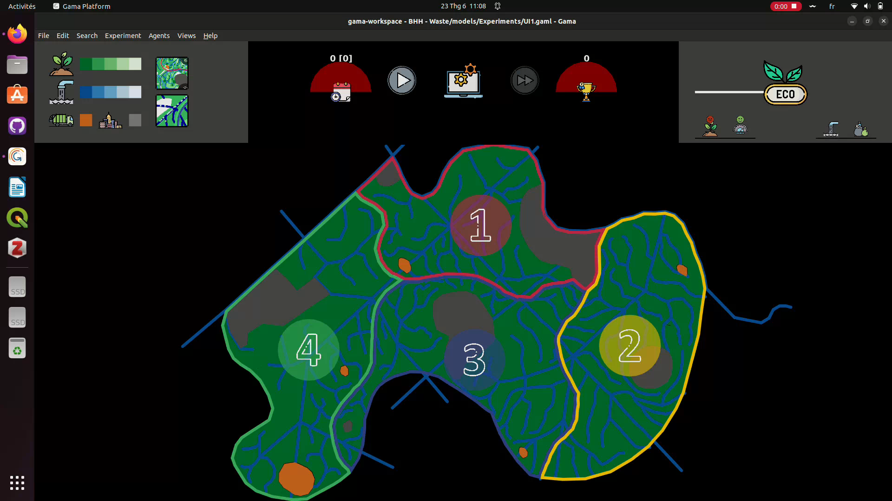
V) Presentation of the participatory simulation

Slide 9
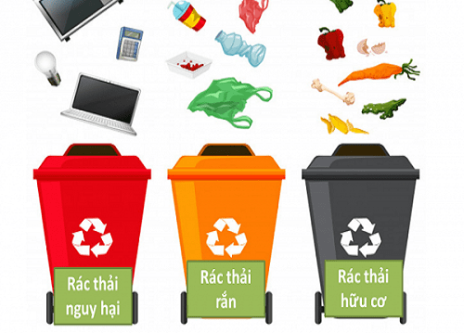
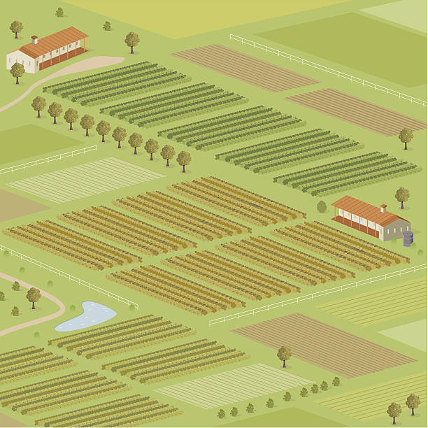


V) Presentation of the participatory simulation
Examples of action cards :
Action 1: Waste collection
Action 6: Organize events to raise awareness on recycling
Action 9: Put in fallow ⅓ of agricultural land
Improve frequency to 4 times/week
Pollution in fields
Productivity decreases for a year but increases during the following year
Solid waste in urban areas
(on the long term) Solid waste in the village
40 tokens

Slide 10
V) A few enhancements in GAMA software
Creation of a QR code plugin to scan chosen actions
Creation of an androïd application to offer another experience of the game based on the use of tablets
Other enhancements for a better flexibility in design and interface

Slide 11
Thank you !

